Slide 1
Performance Management & Appraisal training Workshop

Slide 2
Agenda
Recognise the purpose of performance management and the role of appraisals in this
Identify ways to enhance how to hold effective appraisals
Identify actions to encourage engagement in the appraisals process – WIFIM
Be able to set SMART objectives
Recognise how to handle and manage tricky conversations
Notes:
Explain the purpose of appraisals, what we want to achieve
SAY: We will also look at
How to approach broach any difficult topics that come up, for example quite often people take the opportunity to discuss a pay
The best motivational language to use
How to encourage staff to engage with the process. We ask staff to complete the form prior to their appraisal
so that they have had a chance to think about the areas covered and their achievements throughout the year
but that doesn’t guarantee engagement.
Explain how to set objectives.

Slide 3
Your take-aways ….
In traduce yourself and identify by the end of this session:
I would like to be able to
I want to know more about ..
I would like to know how to improve on ….
This Photo by Unknown Author is licensed under CC BY-NC-ND

Slide 4
What is Performance management?
“Performance management is the process by which an organizational leader, manager or supervisor monitors and evaluates the work of the employees they're responsible for overseeing’
By:
Establishing objectives for individuals and teams to see their part in the organisation’s mission and strategy.
Improving performance among employees, teams and, ultimately, organisations.
Holding people to account for their performance by linking it to reward, career progression and termination of contracts.
Appraisals are used as the means to do this
Notes:
Reference the CIPD guides and fact sheets
https://www.managementstudyguide.com/performance-appraisal.htm
https://www.cipd.org/uk/knowledge/factsheets/performance-factsheet/#:~:text='Performance%20management'%20describes%20the%20attempt,line%20with%20an%20organisation’s%
This is an excellent fact sheet from CIPD is managers need further information u

Slide 5
Why are appraisals important ?
helps with goal setting
allows you to better engage your team
can improve productively
helps to establish transparency
can help employees make improvements
helps recognise the high performers and spot talent
can help you with developing skills
can be motivational ( if done effectively)
can make you feel your manager cares about you as a person
can help spot / address issues before they get worse
This Photo by Unknown Author is licensed under CC BY
This Photo by Unknown Author is licensed under CC BY-SA-NC
Notes:
Ask What conclusions can you draw from this?
In essence appraisals are really important and a key part of driving the business whatever that business is

Slide 6
Pitfalls of effective performance appraisals
Over or under exaggerating recent performances.
An unstructured process in place.
Poor planning
Lack of clarity around their purpose
Inconsistent feedback, goals and next steps .
“Its just a form filling exercise “
No opportunity to discuss development
Rushed or put off – No time
Notes:
Ask what goes wrong with the appraisal process , why don’t people buy in ?

Slide 7
Performance Management Cycle
Notes:
Say holding an appraisal meeting with you DR doesn’t just start with the meeting . This is what the cycle of performance management should look like . This will fit into your appraisal system. This highlights the stages you as a leader should be undertaking with your teams .
Discuss each stage and what you do/ should be doing. SMART objectives into planning .

Slide 8
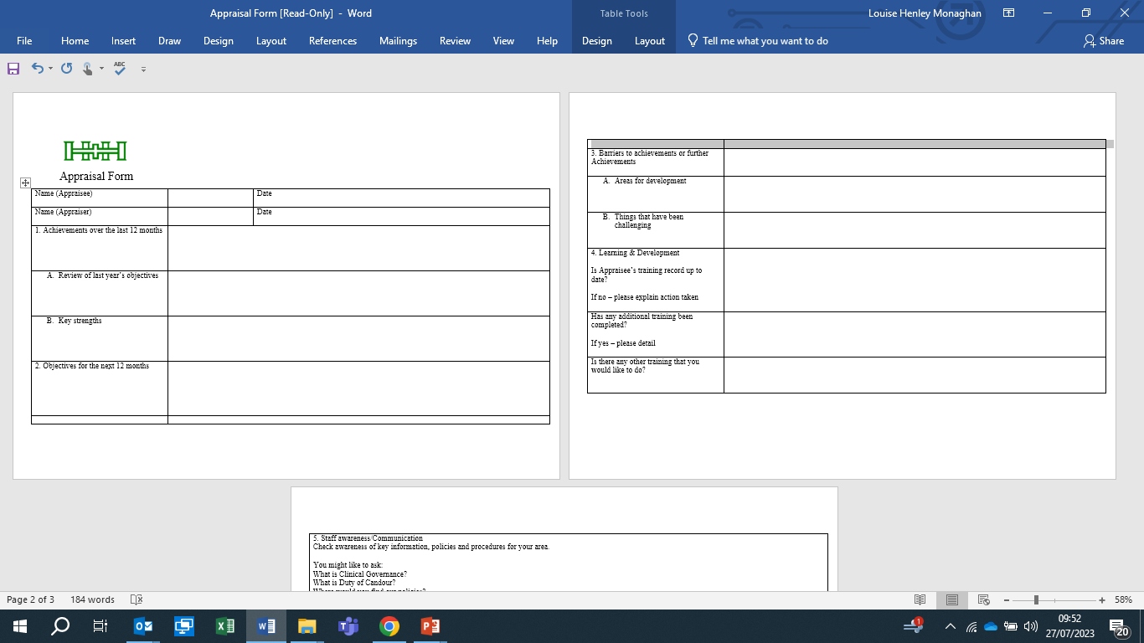
Notes:
Use the apprasail form for reference .
Ask the learners , is there any aspect they feel uncomfortable with or struggle with ?

Slide 9
As a Leader what do you need to do to make the appraisal process a success
Activity : In groups identify activities Before/ during /after the appraisal meeting to ensure its successful ?
What do you need to include in each of these stages ?
Notes:
Whatever you organisation's appraisal system is and how it works , you still need to ensure you’ve covered off these stages .
The planning stage & Review stage are as key as the appraisal meeting itself .
Ensure you identify ways to undertake fair and objective formal assessment, for instance, observations, skills tests, assessment centres, etc.
Know and understand performance standards to enable you to identify and set objectives .
The plan stage is the opportunity to communicate and encourage your employees to prep for their appraisal and for you to prep too
Explain what SMART (specific, measurable, agreed, realistic and time bound) stands for and illustrate with an example.
How would you set standards, for instance, so many calls per hour, number of appointments, number of client visits, etc? Try to give an example for one of your team members.
Once you have identified performance standards in 2.3, explain how you would measure against these standards.
Execute is the meeting itself , where you want to haver a 2 way conversation about performance, development , and generally the wellbeing of your employee .
Review is important to ensure you track progress , deliver any ongoing feedback . Next steps re development , what support might your employee need
.

Slide 10
Every had an appraisal like this?
This Photo by Unknown Author is licensed under CC BY-SA
Notes:
Consider showing this clip The office , David Brent performance review
youtube.com/watch?v=IkYUDQCYGHA
Ask the learners what they think ?
Before showing the next slide ask learners what they see at the point of an appraisal

Slide 11
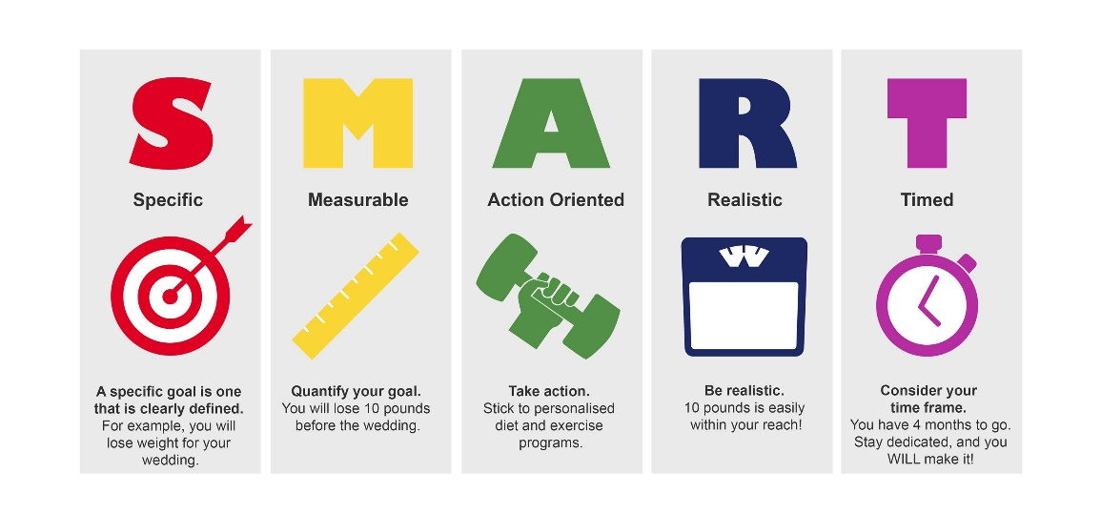
Goal Setting SMART Objectives
This Photo by Unknown Author is licensed under CC BY-NC-ND
Notes:
Don’t make your objectives too big SMART” model is incorrectly considered to be a universal objective formulating method. Use SMART goals to help to define only the stages of a strategy towards long-term plans or big projects.

Slide 12
Setting SMART Goals
Work Goals: Short-term objectives for specific work that can usually be accomplished within a year or a shorter period .
•Development Goals: Goals focused on helping you expand your skills and knowledge and achieve professional career goals
Keep in mind:
•Each goal should state a clear end result or output
•Define quantity, quality, timeliness, and cost
•Make goals challenging but realistically achievable
•Goal is within your scope of work and influence
•State the timeframe or target date for each goal
•

Slide 13
SMART Example - Running a marathon
Specific: I’d like to start training every day to to be fit enough to run a marathon.
Measurable: I will use my Apple Watch to track my training progress as my mileage increases.
Achievable I’ve already run a half-marathon this year, so I have a solid base-fitness level.
Relevant: I value my health and wellness, and this goal will help me sustain that.
Time-bound: The marathon is a year away, so I need to be ready by then.
Notes:
https://goalbuddy.io/smart-goals-2/?gclid=Cj0KCQjw5f2lBhCkARIsAHeTvlhPp6ZN6D_SuFr4BzxtnC13T3wEO3yg83C5zd5y9LCSyf4zgPfPdHsaArPUEALw_wcB
What do you think of this as a SMART goal ? l

Slide 14
Smart Goals -Activity
Rewrite one of following as a SMART Goal :
Become a team leader
Move into x role
Study for my x qualification
Be able to complete x procedure or use y equipment without supervision
Any other examples we could use ?

Slide 15
How to engage - the WIFIM
Different strokes for different folks
Two way conversation
Make employee’s feel valued
Celebrate successes and share feedback
Identify next steps or opportunities for development
Correct performance before it becomes an issue
Build relationships and trust
Don’t let it slip or fall of your “to do list “
Create the culture that encourages people to buy in
Notes:
https://www.trakstar.com/blog-post/how-to-increase-employee-buy-in-to-the-appraisal-process/#:~:text=Give%20employees%20a%20voice.,implement%20changes%20based%20on%20

Slide 16
Activity – Your action plans
Line Manager
Stretching job objectives
Regular 121s
Regular feedback
Clearly defined measures
Culture of openness
In groups consider each of these areas :
Are there activities or actions within your span of control
you recognise you could:
Start doing
Do more of
Improve on

Slide 17
What is a tricky conversations
It is a conversation where you have to manage emotions and information in a sensitive way to and can be challenging to address :
It may involve giving some constructive feedback
It may involve being challenged
It may involve dealing with questions you can’t answer
In pairs identify situations or conversations you find tricky in appraisal meetings ?
How do you currently respond to these ? ( this isn’t a trick questions )
Notes:
Some examples Address poor performance or conduct
Deal with personal problems
Investigate complaints/deal with grievances
Comfort or reassure someone – for example, if they are to be made redundant
Tackle personality clashes
Deal with potentially delicate situations, such as turning down requests for annual leave or to work flexibly, pay rises .
The conversation usually takes place one-to-one.

Slide 18
Performance issues - Establishing the route cause
Lack of/ poor training
Lack of feedback on performance expectations
Unclear ambiguous objectives
Conflicting priorities
Workloads
Lack of motivation / boredom
Issues outside of work
Lack of meaning
Notes:
You need to find the route cause of why performance isn’t at it should be

Slide 19
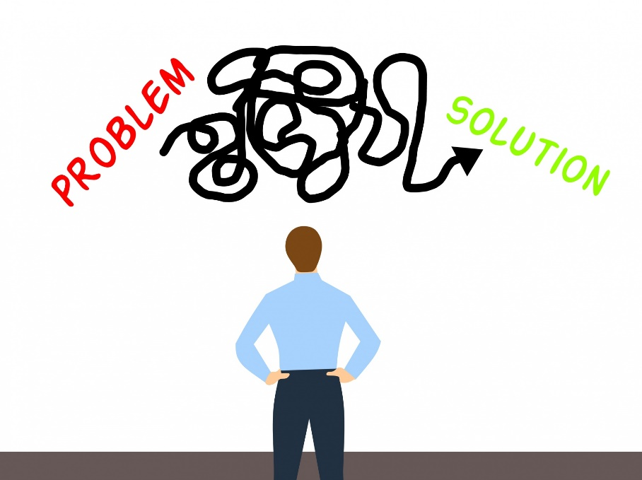
Managing yourself when tackling a tricky conversation
Acknowledge an issue for the individual without taking on the problem
Show empathy not sympathy
Stay in control of your emotions e.g.– Don’t become defensive ,
State what you can do and what you cant do in a professional way
Use active listening
Gather facts & information as to the issue
Don’t be judgemental – focus on the impact of the behaviour or
issue , don’t make it personal
Notes:
Acknowledgement – Don’t take the pen
Staying in control The key to managing difficult conversations is control. You need to control the meeting and how it progresses. This means you decide if and when you need to adjourn for a break and what tactics are working and if you need to change your approach.
More information can be found here
file:///C:/Users/My%20Laptop/Desktop/OM5%20work%20and%20info/managing%20people/Challenging-conversations-and-how-to-manage-them.pdf

Slide 20
Prepare for your conversation
● establish the facts – Don’t act on hearsay
● reflect on what you know about the individual
● get support
● check your policies
● Plan the meeting. What do you know?
check yourself and the purpose of the conversation
If you are dealing with a performance or conduct issue, for example, you need to have the relevant facts at your fingertips. What were the employee’s performance targets and in what way have they failed to meet these targets? Are there any extenuating circumstances – for example, if they have been on sickness absence or training courses do you need to adjust the targets?

Slide 21
Giving constructive feedback
Identify your outcome in giving the feedback before you deliver it.
In your first sentence, identify the topic or issue that the feedback will be about.
Provide the specifics of what occurred.
Start each key point with an "I" message, such as, "I have noticed," "I have observed," "I have seen," or when the need exists to pass on feedback from others, "I have had reported to me." "I" messages help you be issue-focused and get into the specifics
Consider your manner
Be direct – Don’t beat about the bush
Avoid “ need to phases
Be sincere and avoid giving mixed messages
Feedback given well , should not alienate the receiver,, but should motivate them to perform better
This Photo by Unknown Author is licensed under CC BY-NC-ND
Notes:
GIVING CONSTRUCTIVE FEEDBACK
Performance feedback can be given two ways: through constructive feedback or through praise and criticism.
Don't fall into the trap of giving praise and criticism on employee performance.
Constructive feedback is information-specific, issue-focused, and based on observations. It comes in two varieties:
• Positive feedback is news or input to an employee about an effort well done.
• Negative feedback is news to an employee about an effort that needs improvement. Negative feedback doesn't mean a terrible performance, but rather a performance in which the outcomes delivered should be better. So negative is not a negative word in this case.
Praise and criticism are both personal judgments about a performance effort or outcome, with praise being a favourable judgment and criticism, an unfavourable judgment. Information given is general and vague, focused on the person, and based on opinions or feelings.
The guidelines for giving constructive feedback fall into four categories: content, manner, timing, and frequency.
Content
Content is what you say in the constructive feedback.
In your first sentence, identify the topic or issue that the feedback will be about.
Provide the specifics of what occurred.
Without the specifics, you only have praise or criticism. Start each key point with an "I" message, such as, "I have noticed," "I have observed," "I have seen," or when the need exists to pass on feedback from others, "I have had reported to me." "I" messages help you be issue-focused and get into the specifics.
Manner
Manner is how you say the constructive feedback. As you may know, how you say something often carries more weight than what you have to say — manner is an important element when giving feedback.
Be direct when delivering your message. Get to the point and avoid beating around the bush. Both negative and positive feedback should be given in a straightforward manner.
Avoid "need to" phrases, which send implied messages that something that didn't go well. For example, "Jane, you need to get your reports turned in on time, and you need to spell check them." This message is not really performance feedback. It implies that Jane did not do something well with her reports, but it doesn't report exactly what happened. Providing clarity on what occurred is the aim of feedback.
Be sincere and avoid giving mixed messages. Sincerity says that you mean what you say with care and respect. Mixed messages are referred to as "yes, but" messages. For example, "John, you have worked hard on this project, but. . . ." What follows is something the person is not doing well and is the real point of the message. The word "but," along with its cousins "however" and "although," when said in the middle of a thought, create contradictions or mixed messages. In essence, putting "but" in the middle tells the other person, "Don't believe a thing I said before."

Slide 22
Opening up a tricky situation
! I’d like to share some thoughts with you that I think could help us collaborate better”
“I want to share some observations and thoughts with you and understand your perspective on them”
I’m curious about something I’ve noticed and want to get your perspective on it
It looks like we have different perspectives about ______, and I wanted to see if you’d be up for exchanging more thoughts about it so we can understand each other better”
“I’d like to see if we could reach a better understanding about ______ by sharing more of our
thoughts and feelings around it”
I’ve noticed a recurring conversation (conflict, disagreement, problem) we seem to have. I’d like to talk about why that happens.
Notes:
Consider the following statements .
What do you think of these . Could any of these help you with opening up a conversation
Consdier voice tone.
Discuss passive/ aggressive and the impact

Slide 23
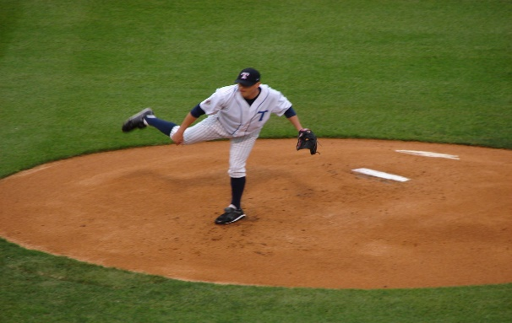
Responding to awkward questions
Set boundaries at the beginning of the conversation. What you will/wont discuss
Anticipate curve balls
Keep Calm and maintain a steady voice tone
Acknowledge the question and how it makes the person feel /why it maters to them.
Explain what you can/cannot do
Don’t let the question take you off on a tangent – stay focused .
Notes:
Its hard to know how to respond when you are put on the spot ! Or you weren’t expecting that question and it takes you off track.
Some hints and tips

Slide 24
Fishbowl

Slide 25
Activity
In pairs : Use examples of your tricky conversations .
Practice with your partner how you would approach this conversation
Identify your outcome for having a conversation
Practice using one of the opening ‘s to deliver the message you want to give or how you would respond to a difficult question .

Slide 26
Your take-aways
Have they been met ?
What actions will you take away from today’s workshop ?
What will you do ?
When will you do it ?
Notes:
Collect answers and actions on flip chart .

Slide 27
Additional slides if needed for this session

Slide 28
CEDAR Feedback Model
C
Context
Describe the context the behaviour usually takes place
E
Examples
Explain past situations that describe the behaviour that is being analysed
D
Diagnosis
Analyse using those examples, what could have been don’t differently
A
Actions
Establish some guidelines to follow That could help improve the behaviour
R
Review
Set up frequent meetings to track progress
Notes:
CEDAR is a framework that can be used to structure feedback conversations in a positive way by allowing the receiver to take the lead in discussions about his or her performance.
The first step is to set the context so that your mentee can see how the feedback fits into their overall performance.
Then describe specific examples to illustrate the situation clearly. In many cases, your mentee will identify examples for themselves
The next step is to help your mentee explore why they are where they are. Understanding what’s behind their performance is essential to learning, whether the feedback is about an area of strength or a gap.
Up to this point the conversation has built awareness; the next step is for your mentee to apply that understanding and decide what actions will be important going forward. Unless they are inexperienced in their role, always encourage them to lead this step
Following up to support and embed any new behaviours is critical.

Slide 29
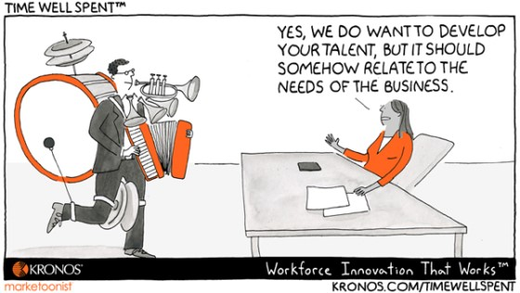
Talent
This Photo by Unknown Author is licensed under CC BY-NC-ND
Notes:
https://www.mindtools.com/aeeg514/talent-management

Slide 30
What is Talent Management
Talent Management is a formal approach for maximizing the contribution that individuals can make, by better using and developing their skills and experience.
“The talent management model” is a way of describing all of the different functions and processes that form your talent management strategy. Traditional talent management model encompasses the following five broad areas:
Planning
Notes:
What do you do in your Business ?
https://www.mindtools.com/aeeg514/talent-management
Encourage learners to read this article on Talent management , it helps to put it into context with performance management

Slide 31
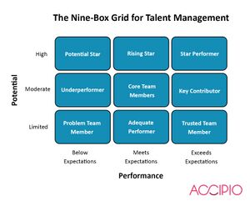
Talent Management models
This Photo by Unknown Author is licensed under CC BY-SA
This Photo by Unknown Author is licensed under CC BY
Notes:
The Potential/ Performance grid is how managers assess their people and identify talent within their organisational
Really helpful to identify potential talent and plan for the transition of talent ( often called succession planning ) Talent

Slide 32
Why is feedback important in managing performance ?
Enable a person to change /improve performance
Identifies performance that needs improvement
Feedback
Builds trust
Reinforces good performance
Is a gift ☺
Can be motivational
Notes:
ASK: Why do you think feedback is important?
Feedback is critical to supporting performance
How can you change or improve performance if you don’t know what it is you need to do ?
Absence of feedback just perpetuate poor performance
It also helps to reinforce good performance and encourage people to continue doing this.
You will need to be able to give your team members feedback that is clear, specific, and honest, but also not judgemental nor overly negative. Focusing on negatives can discourage the individuals you work with.
Developmental feedback - What do you need to do to improve .
Encouragement - there will be times when the purpose of feedback is to offer validation and encouragement. Team members successes should also be celebrated.
Builds Trust - most important thing about quality feedback is that it be honest
Regular, honest and constructive feedback will ensure that the manager / team member relationship remains unbiased and objective.

Slide 33
Using CEDAR to give improvement feedback

Slide 34
Activity
Use examples you have had to give feedback on and using the Cedar model . Identify how you would deliver this. .

Slide 35
Do’s for Giving Feedback
Give it the time it deserves
Give it as soon as possible after the event
Start with ‘I…’ as it is your opinion that you are offering, not a common view
Be clear yourself as to what you are giving feedback on
Make sure you are giving feedback on something that the person can alter or improve (work, performance or behaviour rather than personal characteristics or personality)
Describe or show the specific behaviour or the work
Tell them the effects of their poor behaviour or work
Specify alternatives, what improvements you would expect or the desired result
Ask the person what he or she can do about it
Discuss what they can do to improve.

Slide 36
Don’t for Giving Feedback
Save it all up and give it all at once
Make sweeping and general remarks like ‘this is not up to scratch’
Make it seem as if you are making a statement shared by everybody (by distancing yourself or making it into a definite statement) £ people say you
Criticise something that the person can do nothing about
Leave them unclear as to what they can do to improve
Us the feedback sandwich !

Slide 37
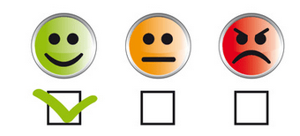
Don’t forget the positive stuff
Feedback isn’t just about when performance needs improving
It encourages and validates the good stuff
Its motivational
It builds relationships and trust
It makes you ( the giver ) feel good too
This Photo by Unknown Author is licensed under CC BY-SA-NC
Notes:
Good link for information on giving feedback

